Slide 1
LAN switching
Rocky K. C. Chang
Chung Yuan Christian University
Dept. Information and computer engineering
May 17, 2023

Slide 2
The problem statement
How do two hosts that are not directly connected communicate with each other?
  Some “intelligent” packet forwarding (or switching) engines have to be in place between the two hosts.
The IP handles the problem on connected heterogeneous networks, e.g., one host on a PPP network and the other on an Ethernet LAN.
This part handles the problem on connected networks of the same or very similar type, e.g., both hosts on a switched Ethernet LAN (or ATM).

Slide 3
The problem statement
Host D
0
Switch 1
Host E
3
1
Host F
Host C
2
Switch 2
2
3
1
0
Host A
Host G
0
Switch 3
Host B
1
3
2
Host H

Slide 4
The problem statement
Layer-two or layer-three switches
  Switching based on the layer-two or layer-three information (headers).
The switches between a source and a destination “work together” to deliver packets between them.
Approaches to switching packets:
  Packet switching (a pure connectionless approach), e.g., switched LANs and IP.
  Virtual circuit (or cell) switching (need connection setup), e.g. ATM.

Slide 5
Switching and forwarding
A switch is a multi-input, multi-output device, which transfers packets from an input to one or more outputs.
  LAN (layer-two) switches, e.g., switched Ethernet, switched token-ring, switched FDDI,
  ATM switches, and
  routers (layer-three switches).
In addition to switching, need protocols and other mechanisms for correct working.
  Switched Ethernet: Learning logic and spanning tree protocol
  IP networks: routing protocols

Slide 6
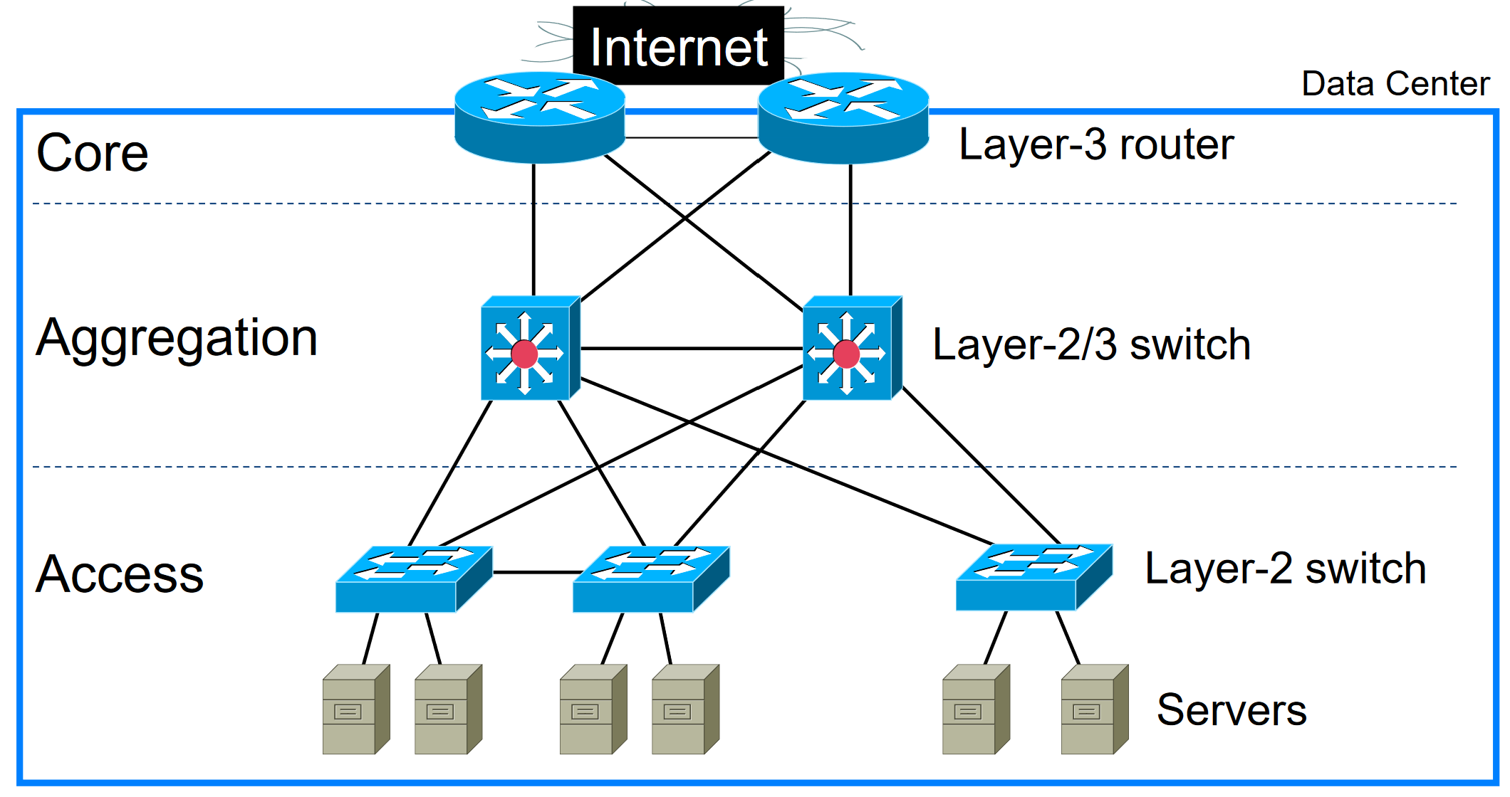
Different kinds of switches

Slide 7
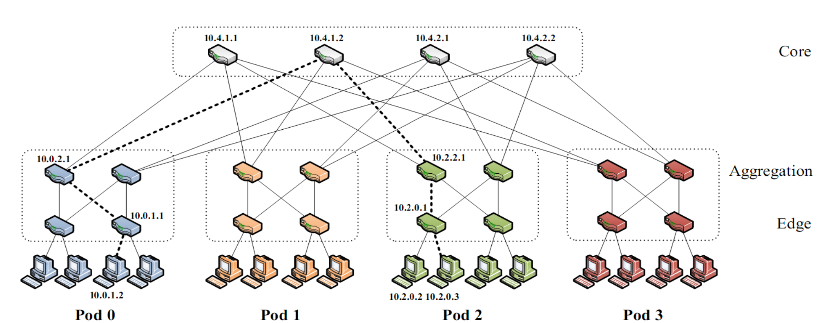
Switching and forwarding

Slide 8
Packet switching
Packet switching refers to a pure connectionless approach.
  Each packet (header) contains enough information for the routers to make forwarding decisions.
When a packet is received, the forwarding decision is based on a table maintained by the switch.
Each table entry consists of
  LAN switch: source MAC addresses and their associated interfaces (or ports)
  IP router: destination IP addresses and the interfaces

Slide 9
Properties of packet switching
Forwarding decision is made packet by packet, even when several packets belonging to the same “flow.”
  Each packet is self-addressed (i.e., containing the destination IP address in the packet header).
No connection set-up is required before sending packets.
  The design for the source is very simple.
  The intelligence lies with the switches.
  Intermediate switches do not keep any “states” (i.e. stateless) about a certain “connection.”

Slide 10
Routing problem in packet switching
Routing problem: How do the switches construct their source address tables/IP routing table?
IP routers are required to run a distributed routing protocol among themselves.
Ethernet LAN switches are required to “remember” the frames they saw and to run a spanning tree protocol among themselves.

Slide 11
Bridges and LAN switches
Problem: How do we connect multiple LAN segments together effectively?
LAN switches are used to interconnect a number of LANs of the same kind to form an extended LAN.
  E.g., Switched Ethernets, switched token rings, switched FDDI.
  It is usually very difficult to connect two different types of LAN using LAN switches.
LAN switches operate mainly at layer two (datalink).

Slide 12
Basic model of a LAN switch
LAN switches are operationally equivalent to transparent bridging (IEEE 802.1D).
  A spanning tree algorithm
  A flat 48-bit MAC address space (for Ethernet)
Each LAN switch consists of
  Forward/filter logic: Make forwarding decisions
  Learning logic: Associate port and MAC addresses
  Port interface: Access ports and network uplink ports
  Source address table: Each entry is associated with an age.

Slide 13
Basic model of a LAN switch
Source Address Table (SAT)
MAC address
Port
Learning Logic
SAT Lookup
Port Interface
Network

Slide 14
Learning logic
A switch listens promiscuously, receiving every frame received.
For each frame received, the switch stores the source MAC address and the port upon which the frame was received in a cache.
  A frame will not use broadcast or multicast addresses as the source address.
The switch ages each entry in the cache and deletes it after a period of time.

Slide 15
Forwarding logic
For each frame received, the switch searches in the SAT for the destination MAC address specified in the frame.
If not found, the switch forwards the frame to all ports except the one from which the frame is received.
If found, and the specified port is different from the one where the frame comes from, the frame is forwarded to the specified port.
Else, the frame is dropped.

Slide 16
An example
Initially, assume the switch’s SAT is empty.
Try this sequence of frame transmission: A→B, B→A, A→Z, Y→A.
A
B
C
Port 1
Switch
Port 2
X
Y
Z

Slide 17
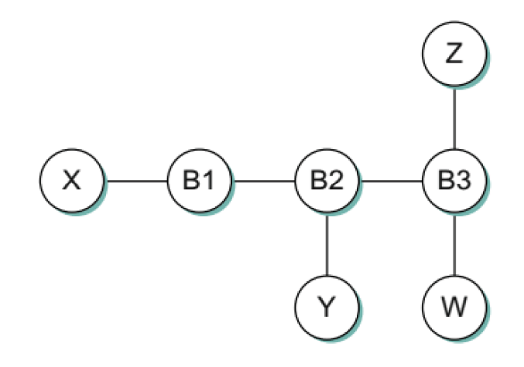
exercise
All SATs are initially empty.
What is the content of the SATs after each step below?
  Y sends a data frame to Z.
  W sends an ARP request for Y’s MAC address.
  Y replies W’s ARP request.
  Y sends a data frame to X.

Slide 18
Switched LANs with loops
Assume that both switches have learnt all the MAC addresses.
Now, when A broadcasts a frame,
  Both B and C receive them.
  Switches 1 and 2 each forward a copy to LAN 2.
  On LAN 2, when switch 1’s copy is received by switch 2,
    It alters the port for A from the upper one to the lower one, and
    it forwards another copy to LAN 1.
Two problems: Incorrect address table and broadcast storm.

Slide 19
Switched LANs with loops
A
B
C
LAN 1
Switch 1
Switch 2
LAN 2
X
Y
Z

Slide 20
A Spanning-tree approach
One approach is to overlay a spanning tree on the network topology.
The spanning tree is “rooted” at an elected bridge, called the root bridge.
On each LAN, at most one bridge’s (not counting the root bridge) port is in forwarding state; others are put into blocking states.
  Frames received at the ports in blocking states will be dropped.
  Frames received at the ports in forwarding states will be processed as usual.
Notes:
One approach to the loop problem is not to connect two segments with more than one bridge. However, parallel bridges are needed to provide resilience to the LAN.
Another approach is to perform source-routing in token-ring LANs (the source node needs to do most of the job and it is not transparent).

Slide 21
A Spanning-tree approach
If bridge 1 is elected as a root bridge,
A
B
C
LAN 1
Bridge 1
Bridge 2
LAN 2
X
Y
Z

Slide 22
exercise
Form a “best” spanning tree for this typical network setup.

Slide 23
Spanning tree protocol (stp)
The bridges transmit messages (BPDUs) to one another to compute a spanning tree.
The BPDUs contain enough information so that switches can
  elect a root bridge,
  find a shortest path from themselves to the root bridge.
    For each LAN, elect a designated bridge that is one closest to the root bridge.
    Choose a port (root port) that gives the shortest path from themselves to the root bridge.
  Include root ports and any ports on which self has been elected designated bridge.

Slide 24
stp: EXAMPLE
A
B
B3
C
B5
B2
D
B7
K
E
F
B1
G
H
B6
B4
I
J

Slide 25
stp: EXAMPLE
A
B
B3
C
B5
B2
D
B7
K
E
F
B1
G
H
B6
B4
I
J

Slide 26
stp: EXAMPLE
A
B
C
B5
B2
D
B7
K
E
F
B1
G
H
B4
I
J

Slide 27
stp: EXAMPLE
A
B
B3
C
B5
B2
D
B7
K
E
F
B1
B1
G
H
Root bridge
B6
B4
Root ports
I
J

Slide 28
stp: EXAMPLE
A
B5
B5
B
B3
C
B5
B2
B7
B2
D
B7
K
B1
E
F
B1
B1
B1
B1
G
B1
B1
H
Root bridge
B6
B4
Root ports
I
B4
J
Designated bridges
B4

Slide 29
stp: EXAMPLE
A
B5
B5
B
B3
C
B5
B2
B7
B2
D
B7
K
B1
E
F
B1
B1
B1
B1
G
B1
B1
H
Root bridge
B6
B4
Root ports
I
B4
J
Designated bridges
B4

Slide 30
The STP BPTU
Each BPDU contains
  the ID for the bridge that is sending this message,
  the ID for what the sending bridge believes to be the root bridge,
  the distance, measured in hops, from the sending bridge to the root bridge.
Each bridge records the current best BPDU message it has seen on each of its ports.
The new BPDU is considered better than the currently recorded information if
  It identifies a root with a smaller ID, or
  It identifies a root with an equal ID but with a shorter distance, or
  The root ID and distance are equal, but the sending bridge has a smaller ID.
Notes:
It is easy to construct a spanning tree when the entire topology is available.
But, how can each bridge get all the information it needs when the whole topology is not available.

Slide 31
The stp Bptu: EXAMPLE
Initially, every bridge, say B1, sends out (B1, B1, 0) onto all of its ports.
  The one that has the smallest id is elected to be the root bridge.
Then, B2, B4, B5, B6, and B7 send out (Bx, B1, 1) onto the attached LANs other than the ones attached to B1.
Then, B3 sends (B3, B1, 2) onto LAN A.

Slide 32
The stp Bptu: EXAMPLE
A
B
B3
C
B5
B2
D
B7
K
E
F
B1
G
H
B6
B4
I
J

Slide 33
The stp Bptu: EXAMPLE
Designated bridges:
  LAN A: B5 (closer than B3)
  LAN B: B5 (id smaller than B7)
  LAN C: B2 (closer than B3)
  LAN D-H: B1 (closer than other bridges)
  LAN I: B4 (id smaller than B6)
  LAN J: B4 (the only bridge)
  LAN K: B7 (the only bridge)

Slide 34
exercise
Label the root ports by circles.
Write down the designated bridge’s ID next to each LAN.

Slide 35
Benefits & limitations of switched Network
Benefits:
  A switched network is generally much faster and more cost-effective than a routed network.
  Support virtual LANs.
  Practical experience shows that switched networks can provide good-quality streaming video.
Limitations:
  Special attention to avoid broadcast storm (including multicast), thus limiting its scalability.
  Limit the types of LANs connected by switches.
  The spanning tree does not support load balancing.

Slide 36
Virtual LANs
Virtual LANs allow a group of hosts that may not be connected to the same LAN to appear to be in the same LAN.
W
X
VLAN 100
B1
VLAN 200
Y
Z

Slide 37
Virtual LANs
W
X
VLAN 100
B1
B2
VLAN 200
Y
Z

Slide 38
Virtual LANs
A1
A2
A3
A4
B1
B2
Z1
Z2
Z3
Z4

Slide 39
Virtual LANs
Virtual LAN membership can be determined based on
  Switches’ port numbers
  Hosts’ MAC addresses
  Hosts’ upper-layer network addresses, such as IP addresses.
IEEE 802.1Q for supporting VLAN: adding a VLAN in the Ethernet header

